Slide 1
FreeBies FOR NewBIES
Team Members:
Aditya Krishna Raavi
Manoj Kumar Gude
Harish Chowdary Bala
Saibabu Devarapalli
Jaichand Mulakalapalli
Client & Mentor:
DR. CHANDRA MOULI KOTTETI
A place to find free event and items

Slide 2
Team Members
JAICHAND MULAKALAPALLI
(TEAM LEADER) BACKEND
MANOJ KUMAR GUDE
FRONTEND
ADITHYA KRISHNA RAAVI
FRONTEND
Saibabu devarapalli
Fullstack
HARISH CHOWDARY BALA
DATABASE
DR. CHANDRA MOULI KOTTETI
Mentor & Client

Slide 3
Contents
Introduction
Tools
Android Studio IDE
Android UI
Layout Designs
Back4App Database
Database Dependencies
Registration Page Java Code
Login Page Java Code
Login/Registration Demo
Lessons Learned
Summary

Slide 4

Introduction
Freebies for Newbies is an android application.
To develop this application, we used agile software methodology.
By this application we help international students to find free stuff and events in the desired location.
Many of the international students doesn’t aware about events happening in college
By entering the zip code to the application user can get the Free stuff and event details in the application.
Once the user downloaded the application the user has to register for an account.
After registration completed the user can login to register for event
Freebies For Newbies

Slide 5




Tools used
Android Studio - The tool used for
the UI development.
GenyMotion - Emulator (Virtual device )
Git Hub – To integrate UI part and store it.
Eclipse - Used to develop the code.
Oracle VirtualBox – Its an essential tool
required to run for GenyMotion.
Back4App – Database .

Slide 6

Android studio ide
Android Studio is the Official Integrated Development Environment (IDE) for Android App Development.
IntelliJ IDEA, Visual Studio, Eclipse, Xamarin, and Xcode are the most popular alternatives and competitors to Android Studio.
This is a Gradle Based build system.
Build variants and multiple APK integration. Google support for various device types.
Best support for Latest java technologies.
Fast and smart coding Techniques.
Easy and efficient project management.

Slide 7
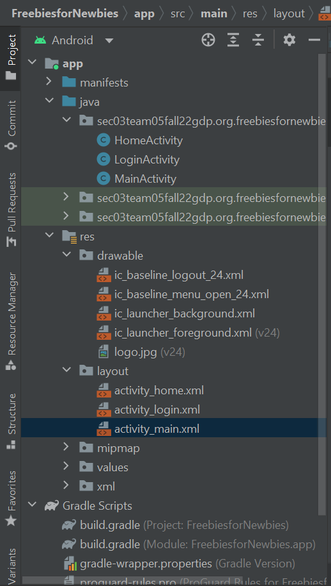
PROJECT STRUCTURE
Manifests
Contains the AndroidManifest.xml
Java
Contains the java source code files, separated by package names, including JUnit test Code.
Res
Contains all non-code resources, such as XML layouts, UI strings, and bitmap images, divided into sub-categories.
Fig 1: Project Structure

Slide 8
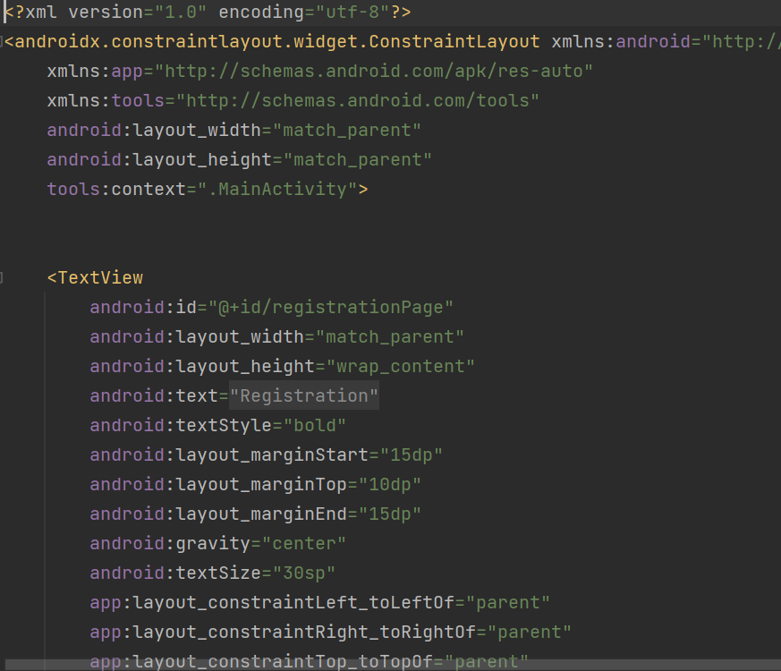
Layouts
Here we used constraint layout, to develop the android UI
Constraint layout is similar to all other layouts.
A Constraint Layout is a View Group which allows you to position and size widgets in a flexible way.
In this layout constraints add to the view on all four sides.
Fig 2 : Constraint layout code

Slide 9
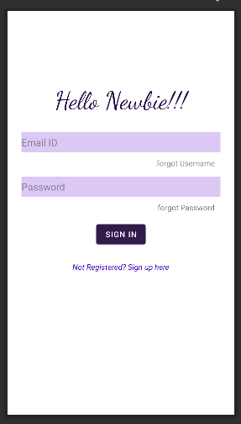
LOGIN Activity
As of now , we designed three activities login page activity, Registration page activity and home page activity.
For the login page we added text view hello newbies.
Edit Text to enter the email id and password.
Button forgot username and forgot password.
Button sign into login.
Button signup/register to register a new account.
Fig 3 : Login page activity

Slide 10
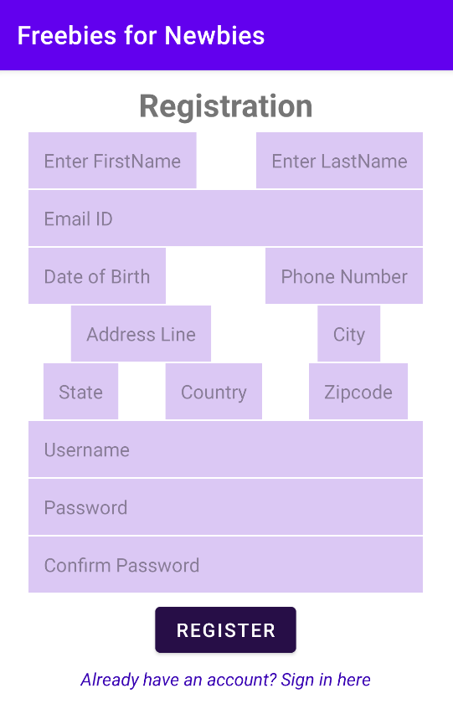
Registration page
Added text view for registration to view the title of the activity.
Edit view such as First name, last name, enter email, username, enter phone number , enter password, re-enter password.
Entering user details in edit view to register.
Button register is to register as a user by entering details.
Button already have an account and sign in here to redirect to login page.
Fig 4 : Registration page login

Slide 11
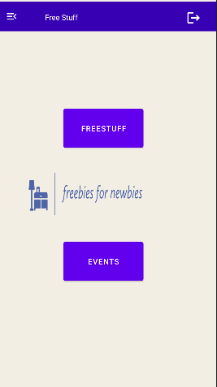
Home PAGE ACTIVITY
Home page is the entry point to the user to what function he wants to do.
If the user click on the free stuff the user can view free stuff available in that area.
If the user click on events the user can view events happening in that area.
Logout button is added to logout from the user account.
Menu is to view the options in the application
Fig 5 : Home Page activity page

Slide 12

Back4App
It has few dependencies before we can use Back4App in our android application.
Parse Android SDK’s
This is will help user registration and login Process.
Android App Permissions :
We need to Add AndroidManifest.xml file right after the application tag.
<uses-permission android :name = “android.permission.ACCESS_NETWORK_STATE ” />
<uses-permission android :name = “android.permission.INTERNET” />
Module App :
In settings file we add two more repositories like JCenter and Maven(Sometimes It is Default)

Slide 13
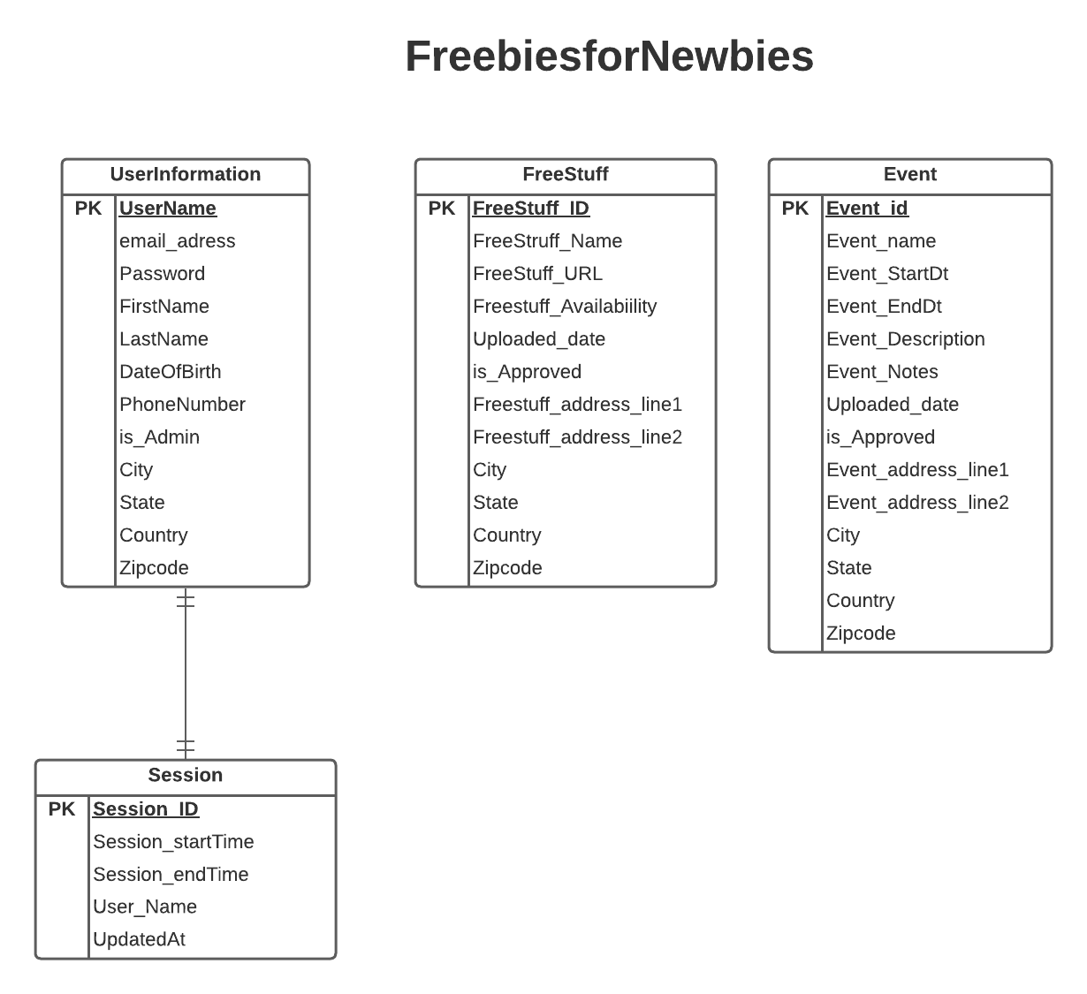
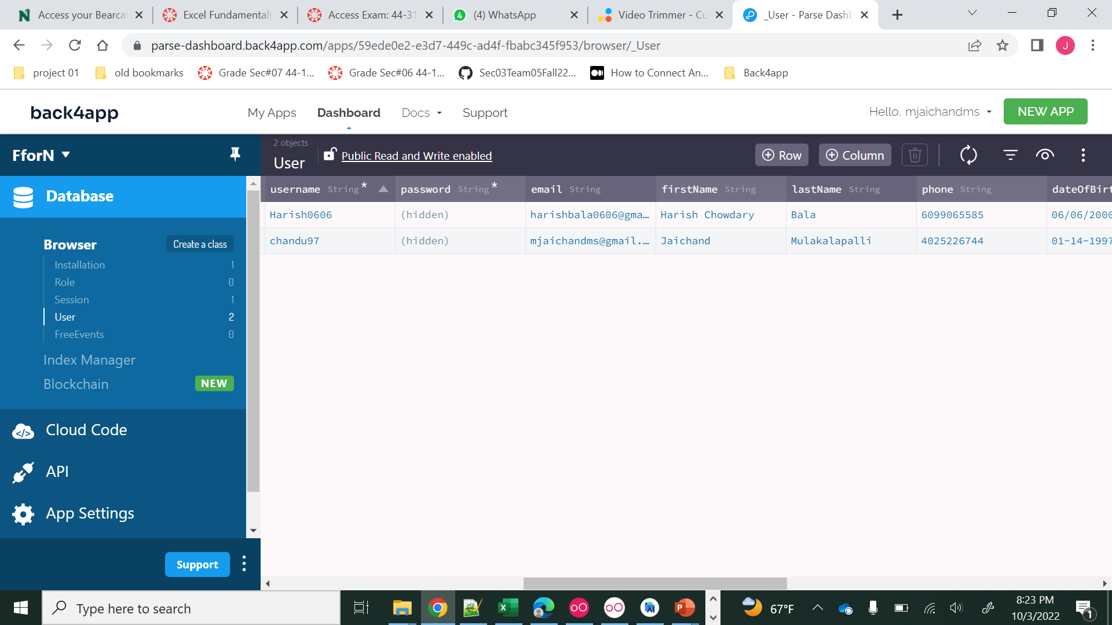
Back4App
Fig 6.1: Back4App Console
Fig 6.2: ER Diagram

Slide 14
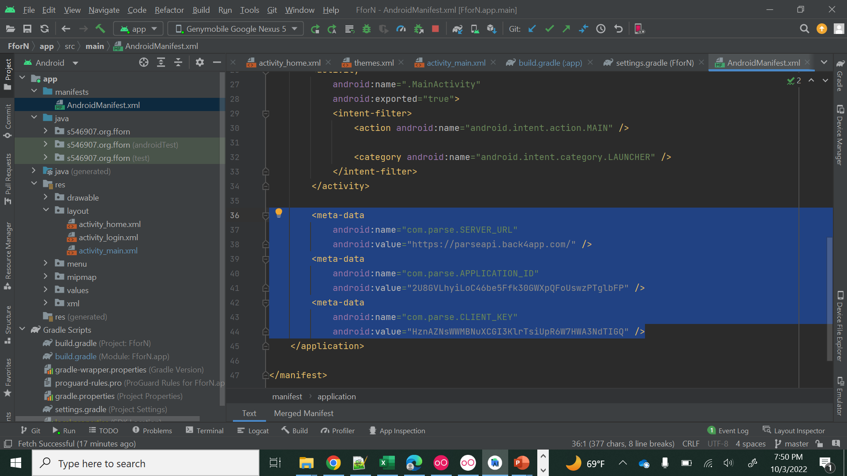
Back4App (AndriodManifest.xml)
Fig 7: Manifest.xml file

Slide 15
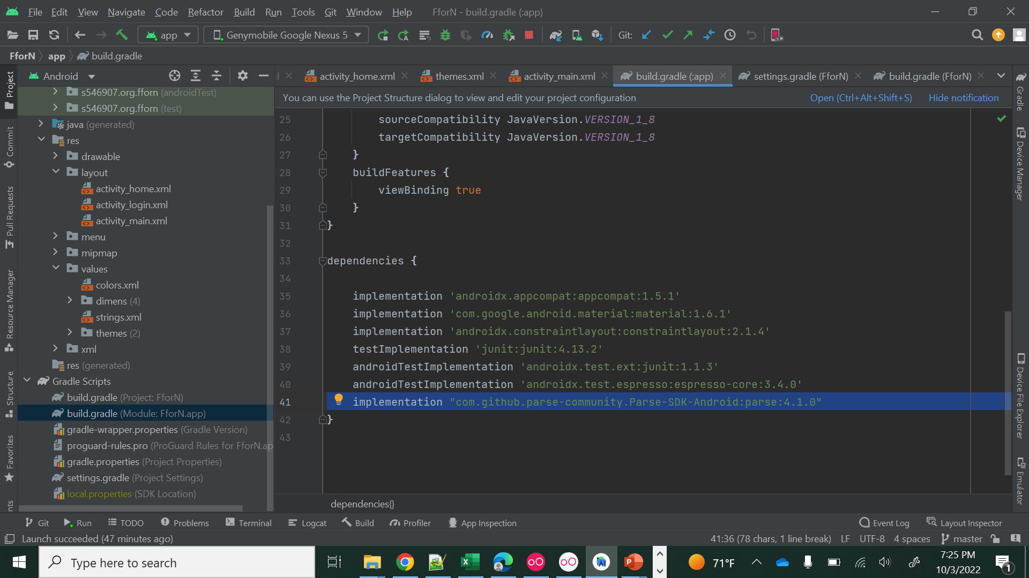
Back4App (Module: app)
Fig 8: Gradle (Module: app) file

Slide 16
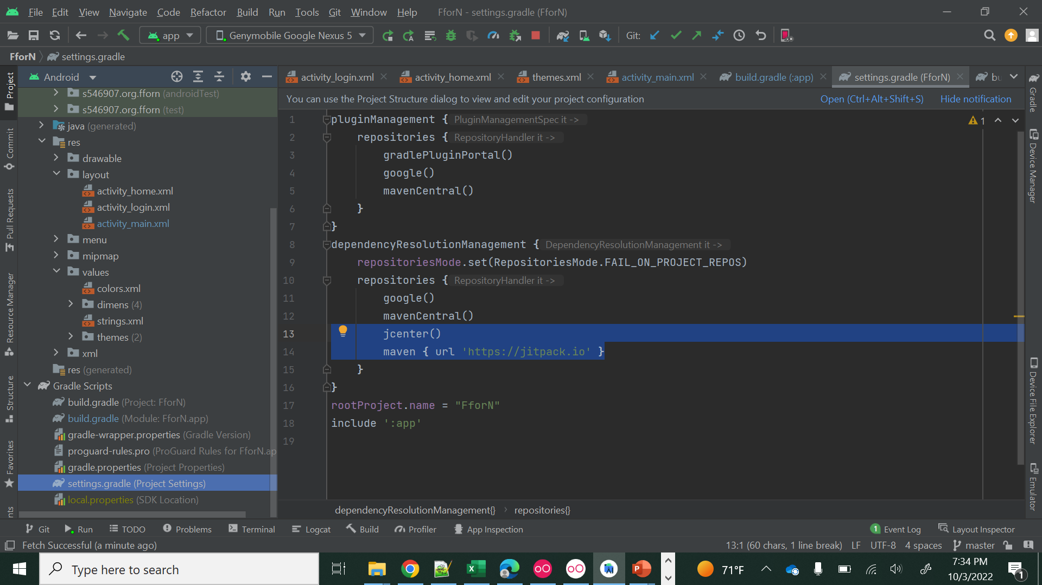
Back4App (settings:gradle)
Fig 9: Gradle (Settings) file

Slide 17
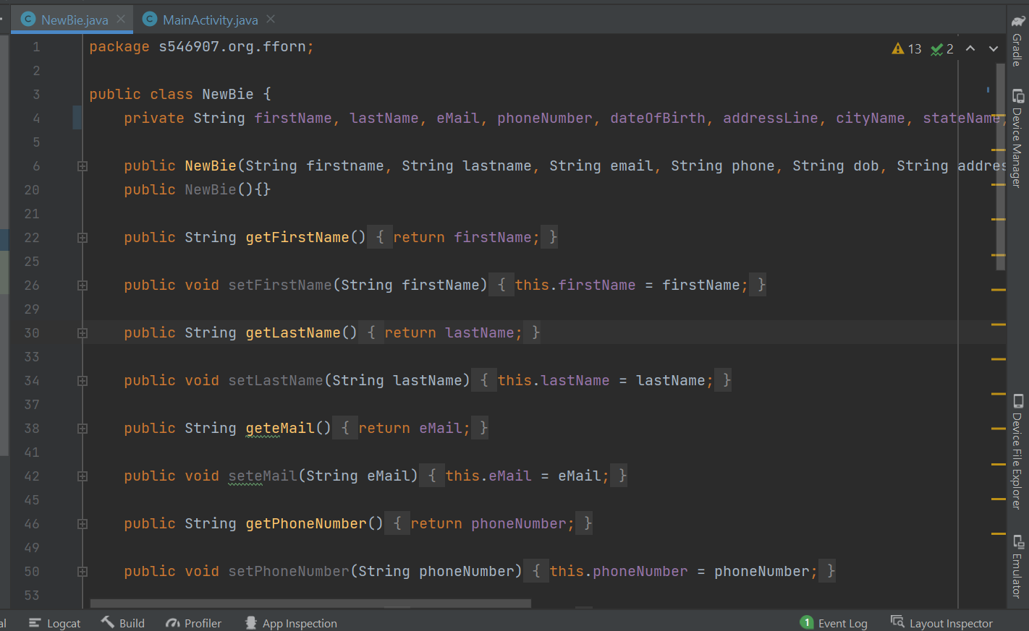
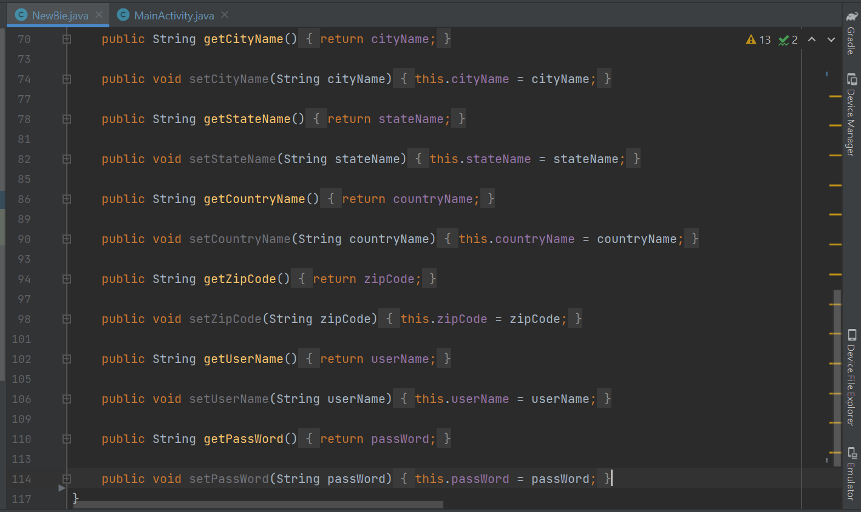
Backend: Newbie Java Class file
Fig 10.1: Java Class code part1
Fig 10.2: Java Class code part2

Slide 18
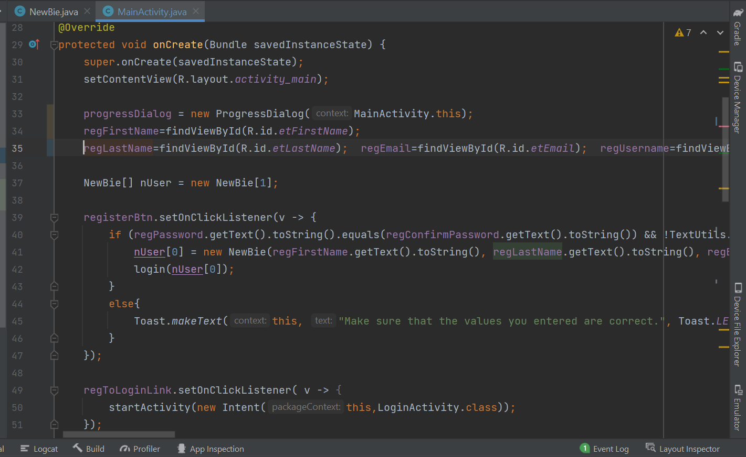
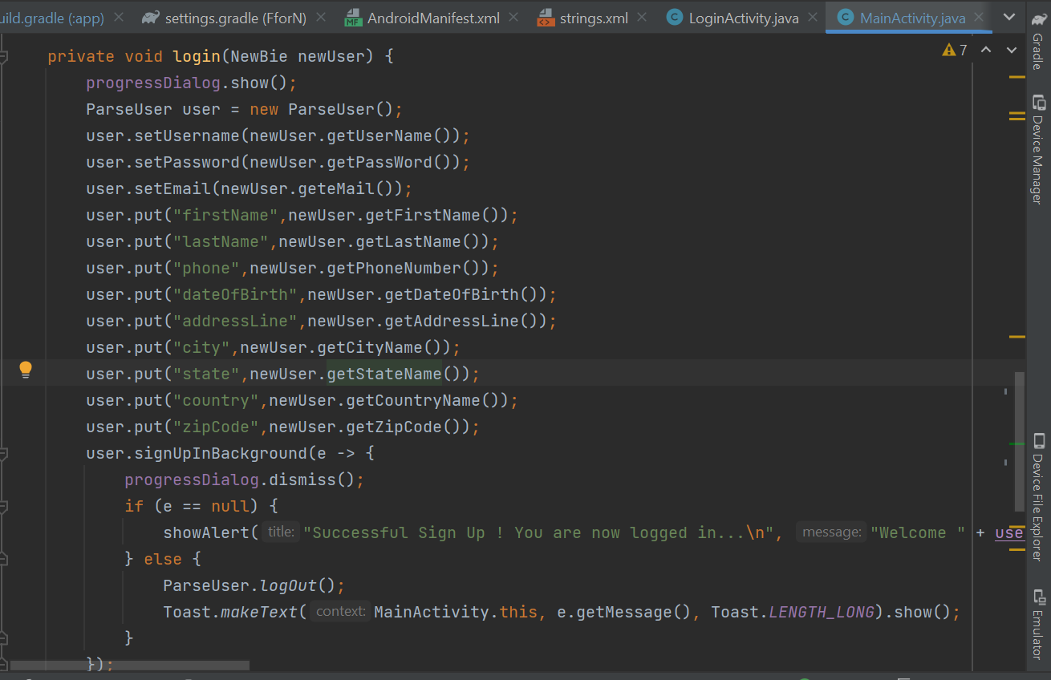
Backend: Registration Activity Java Code
Fig 11.1: onCreate() override method
Fig 11.2: login() method

Slide 19
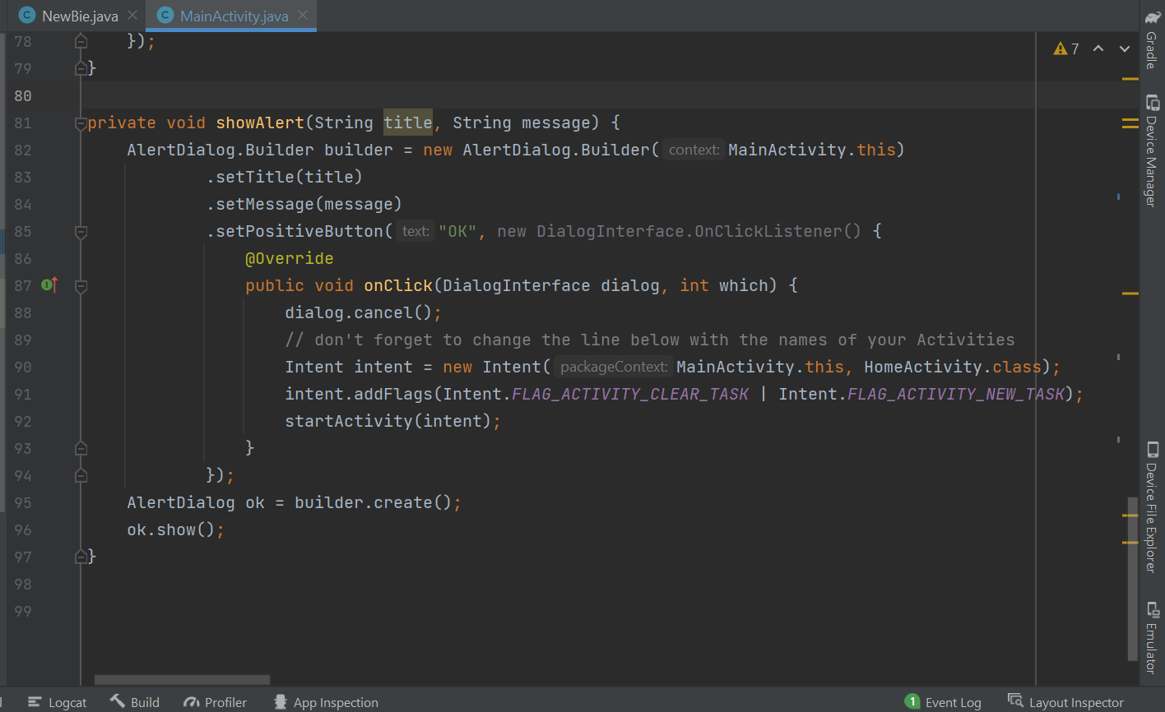
Backend: Registration Activity Java Code
Fig 11.3: showAlert() method

Slide 20
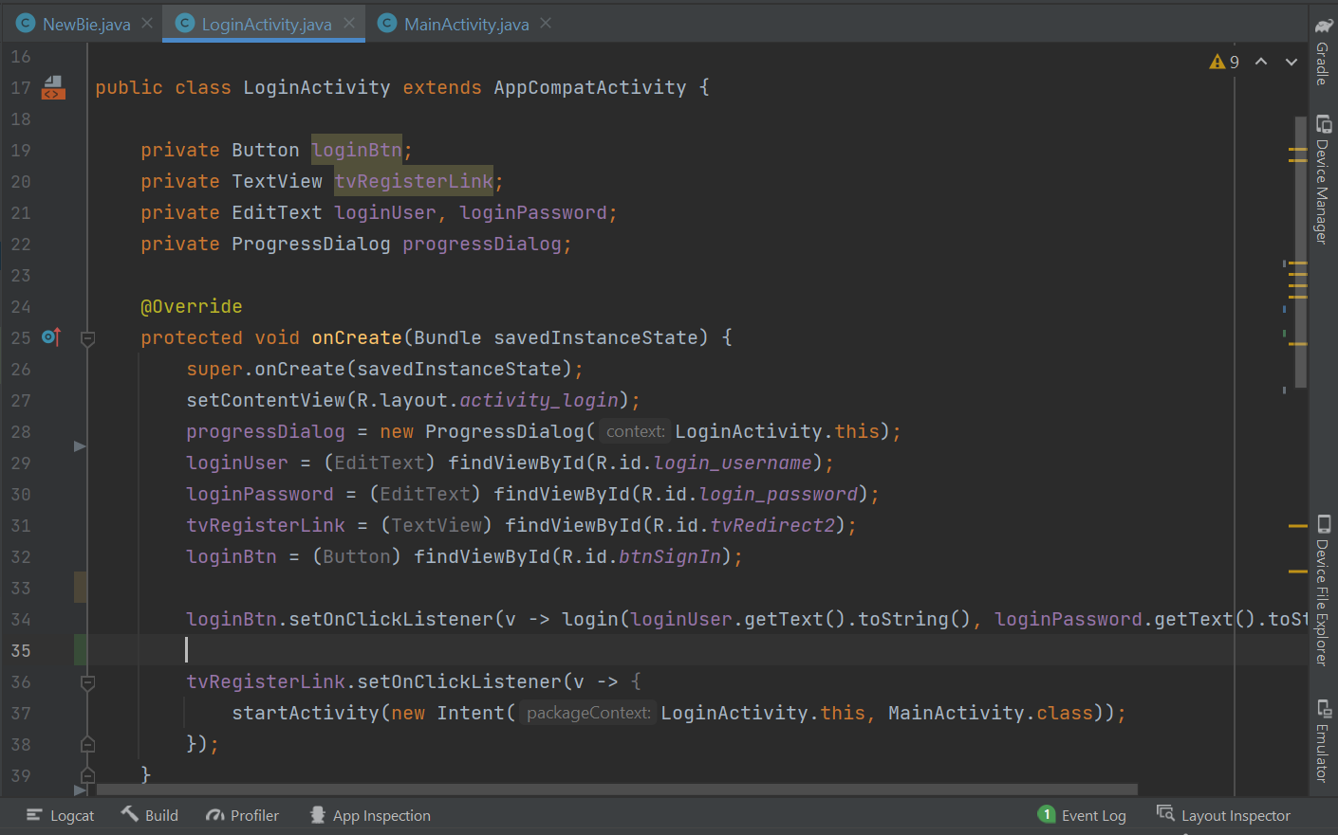
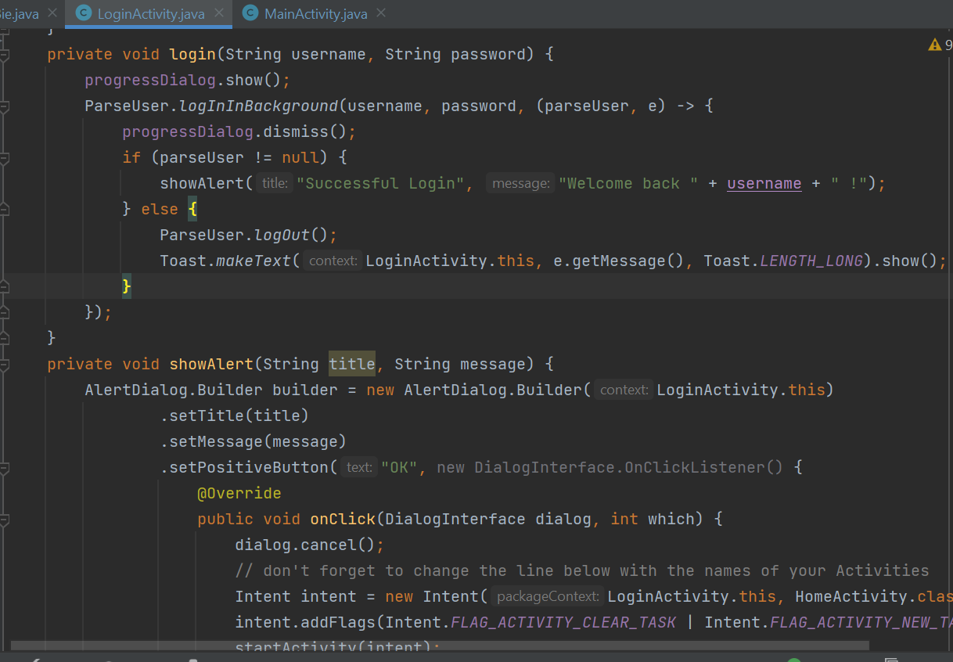
Backend: Login Activity Java Code
Fig 12.1: onCreate() override method
Fig 12.2: login() & showAlert() method

